Slide 1
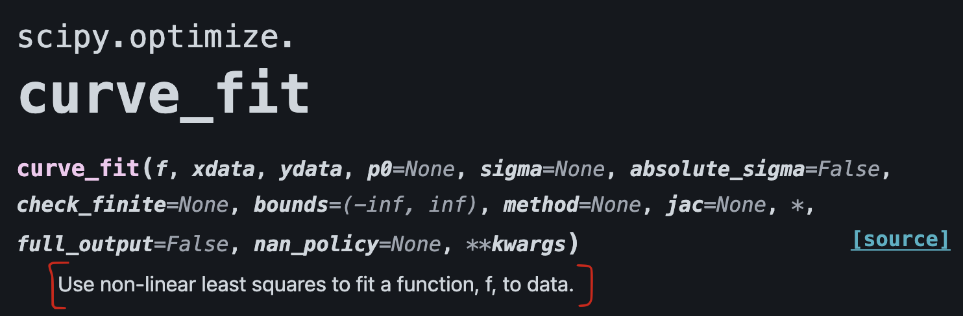
Fitting Models to Data:
What it means to rely on Scipy’s curve_fit package

Slide 2
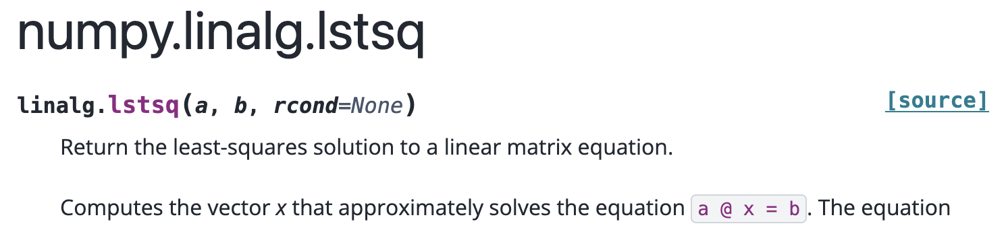
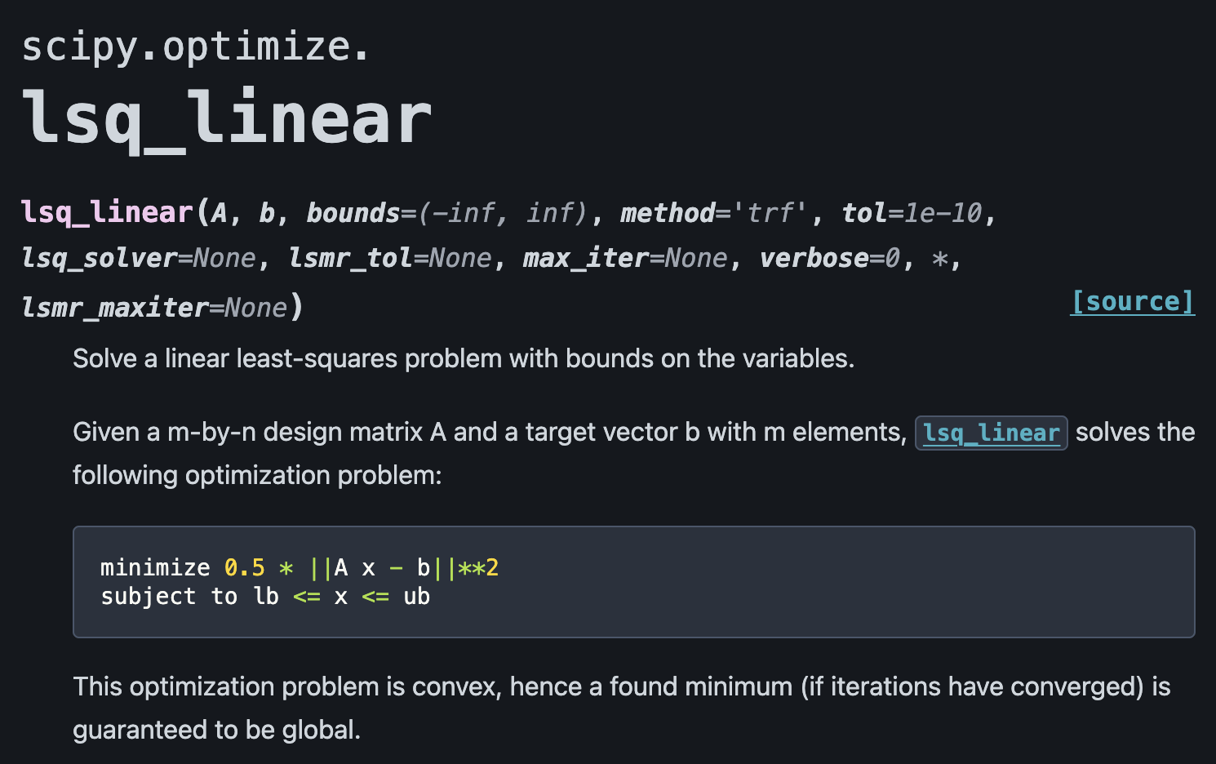
First, what is linear least squares?
These methods can only apply when the model to fit the data is expected to be a linear combo of parameters, e.g.:
y = mx + b
or
y = ax^2 + bx + c (polynomials are linear combos!)

Slide 3
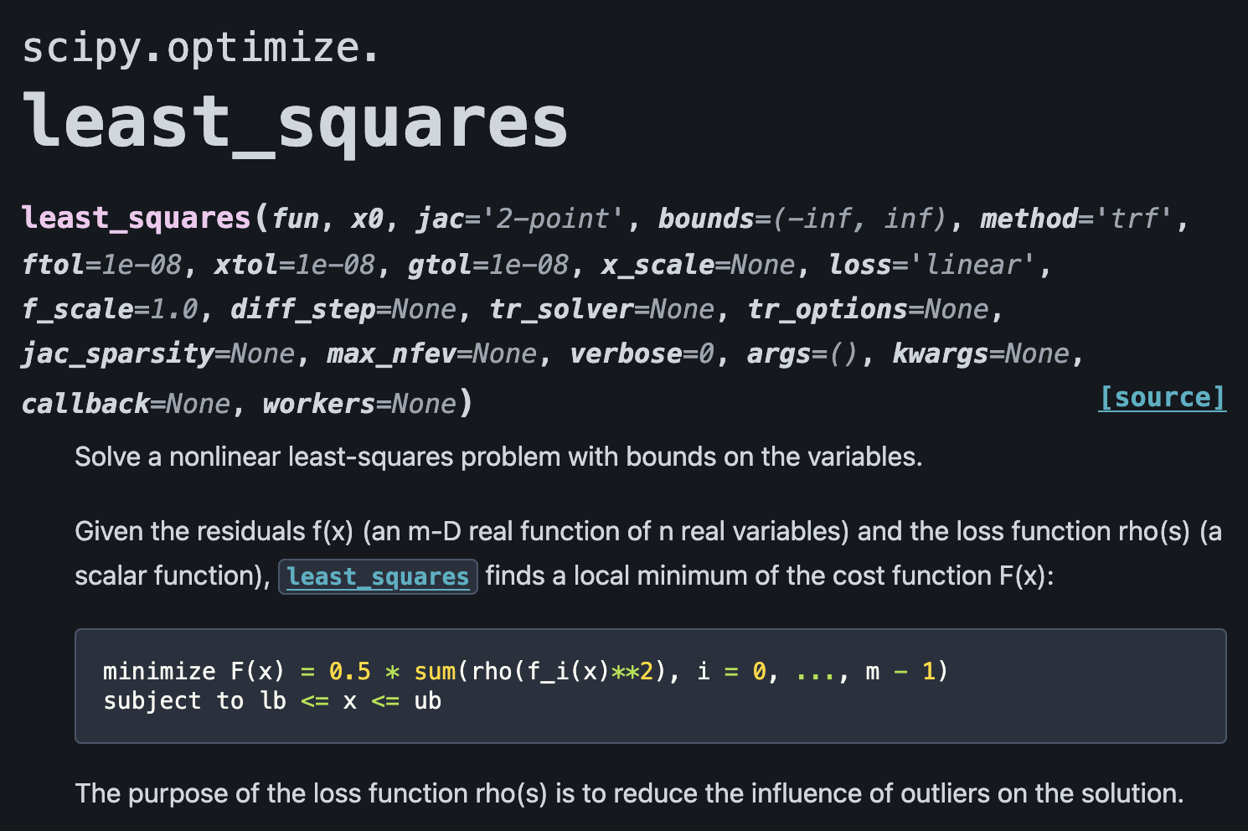
Okay, so what is non-linear least squares?
Broader functions can be used to describe the data, e.g.
y = ae^x
But such solutions can’t be found analytically; we can only test many parameters until we find something that minimizes the distance between the data and our models.

Slide 4
Well . . . can we just do that ourselves?
Yes, of course!
But still, curve_fit is right there to do it fast for us; why wouldn’t we use it all the time?
Well, what if your “models” aren’t callable functions?
What if you have simulation results - discrete datasets of simulated x and y - and you just want to see which simulation fits your real x and y?
This is today’s notebook!

Slide 5
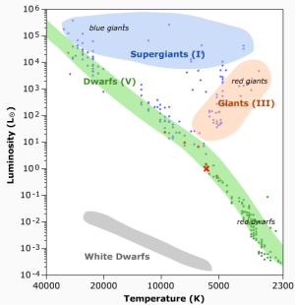
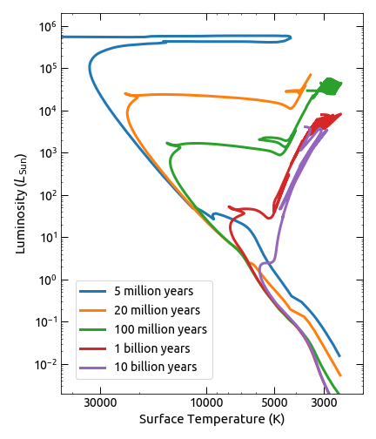
Finally, some background on the science in today’s notebook:

Slide 6
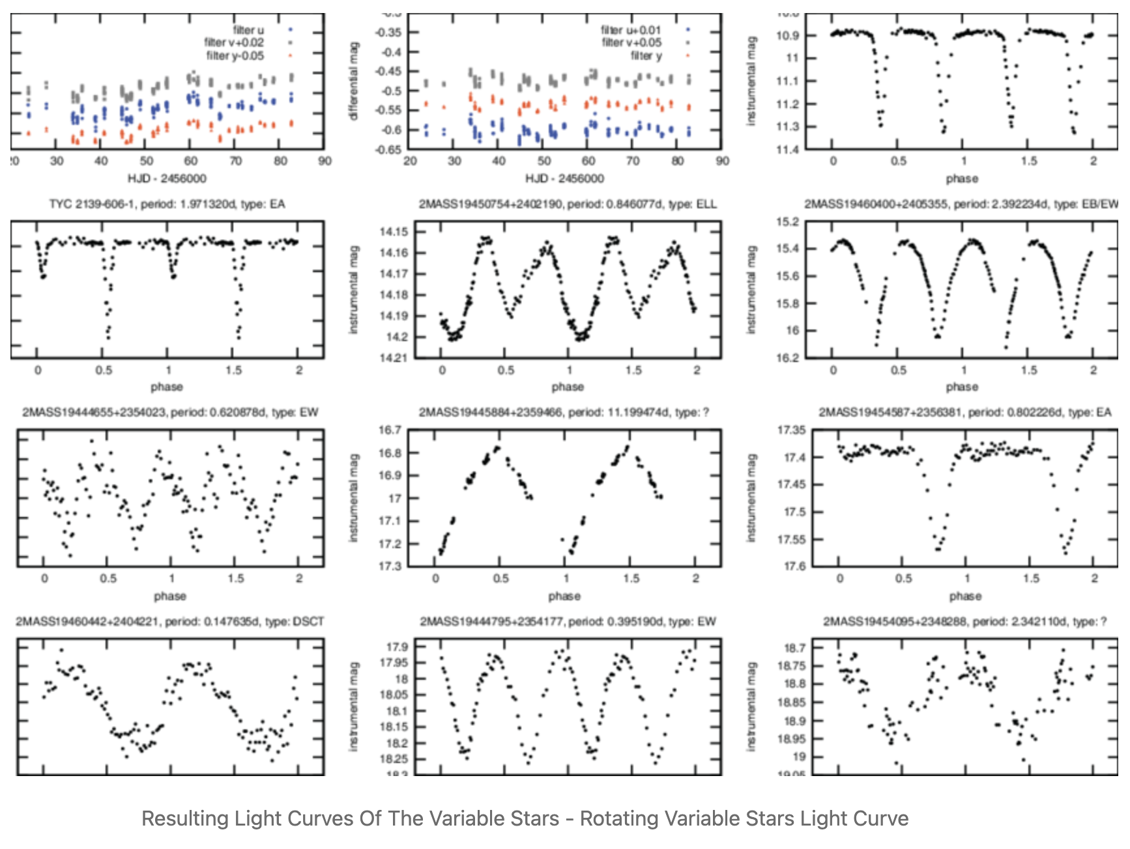
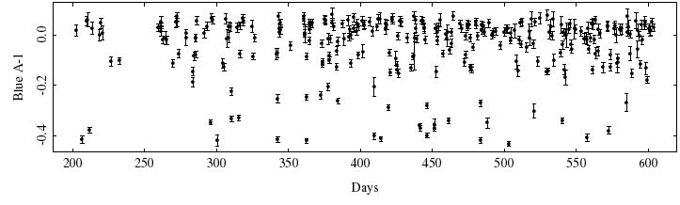
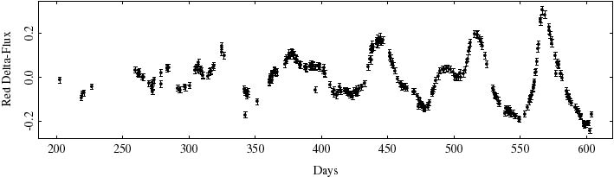
Models within models

Slide 8
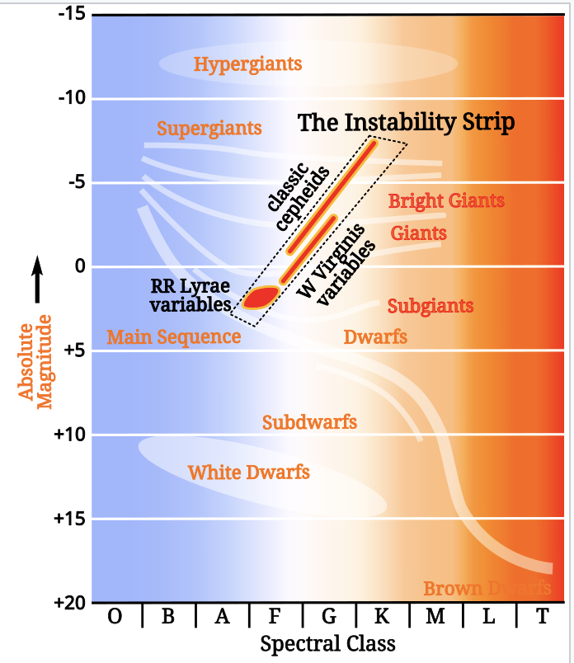
First confirmed RR Lyrae star was discovered by Williamina Fleming
Cepheid period-luminosity relationship was discovered by Henrietta Leavitt
The mass and elemental makeup of stars determine whether they become RR Lyrae, Cepheid Type 1, or Cepheid Type 2

Slide 9
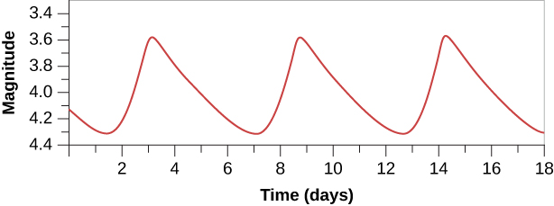
How do you model something periodic?
Functions that describe periodic things!
OR
Use the period itself as a simplified representation of the data!

Slide 10
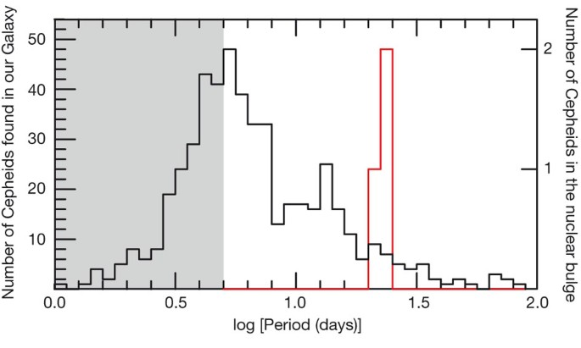
Okay, you’ve modeled your data, and now you have a gazillion Cepheids in a region. What can you do with that data?

Slide 11
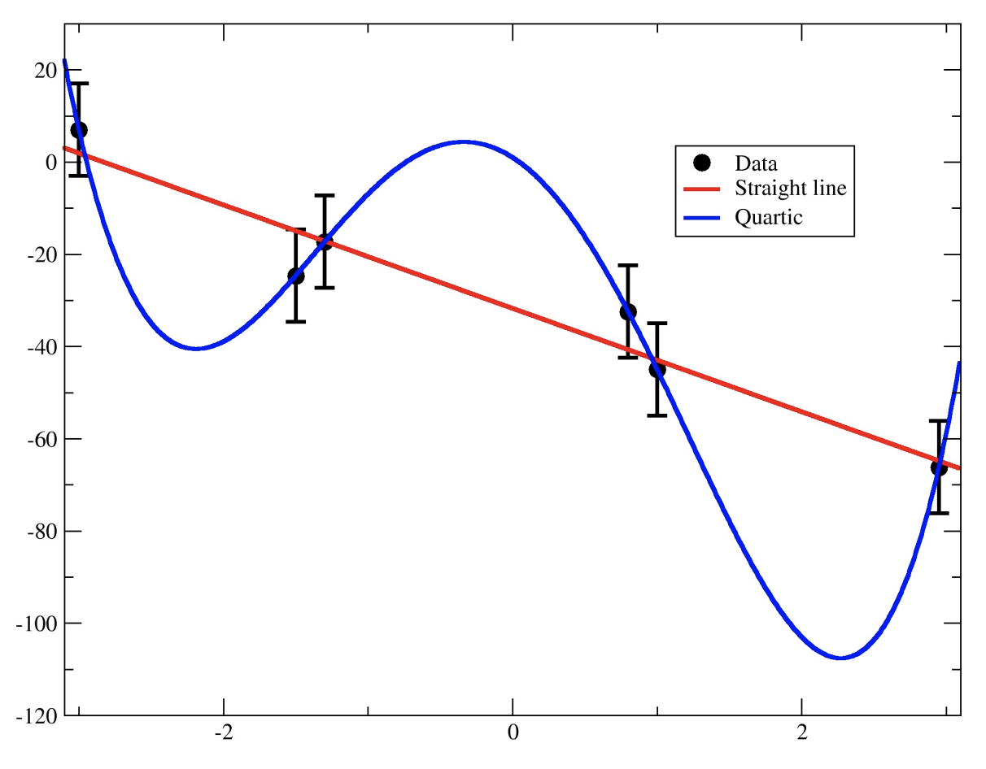
How will you know when you’ve overfit your data?

Slide 12
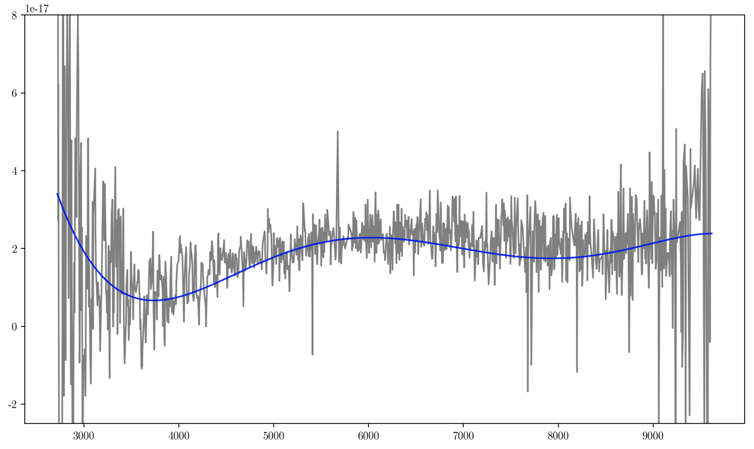
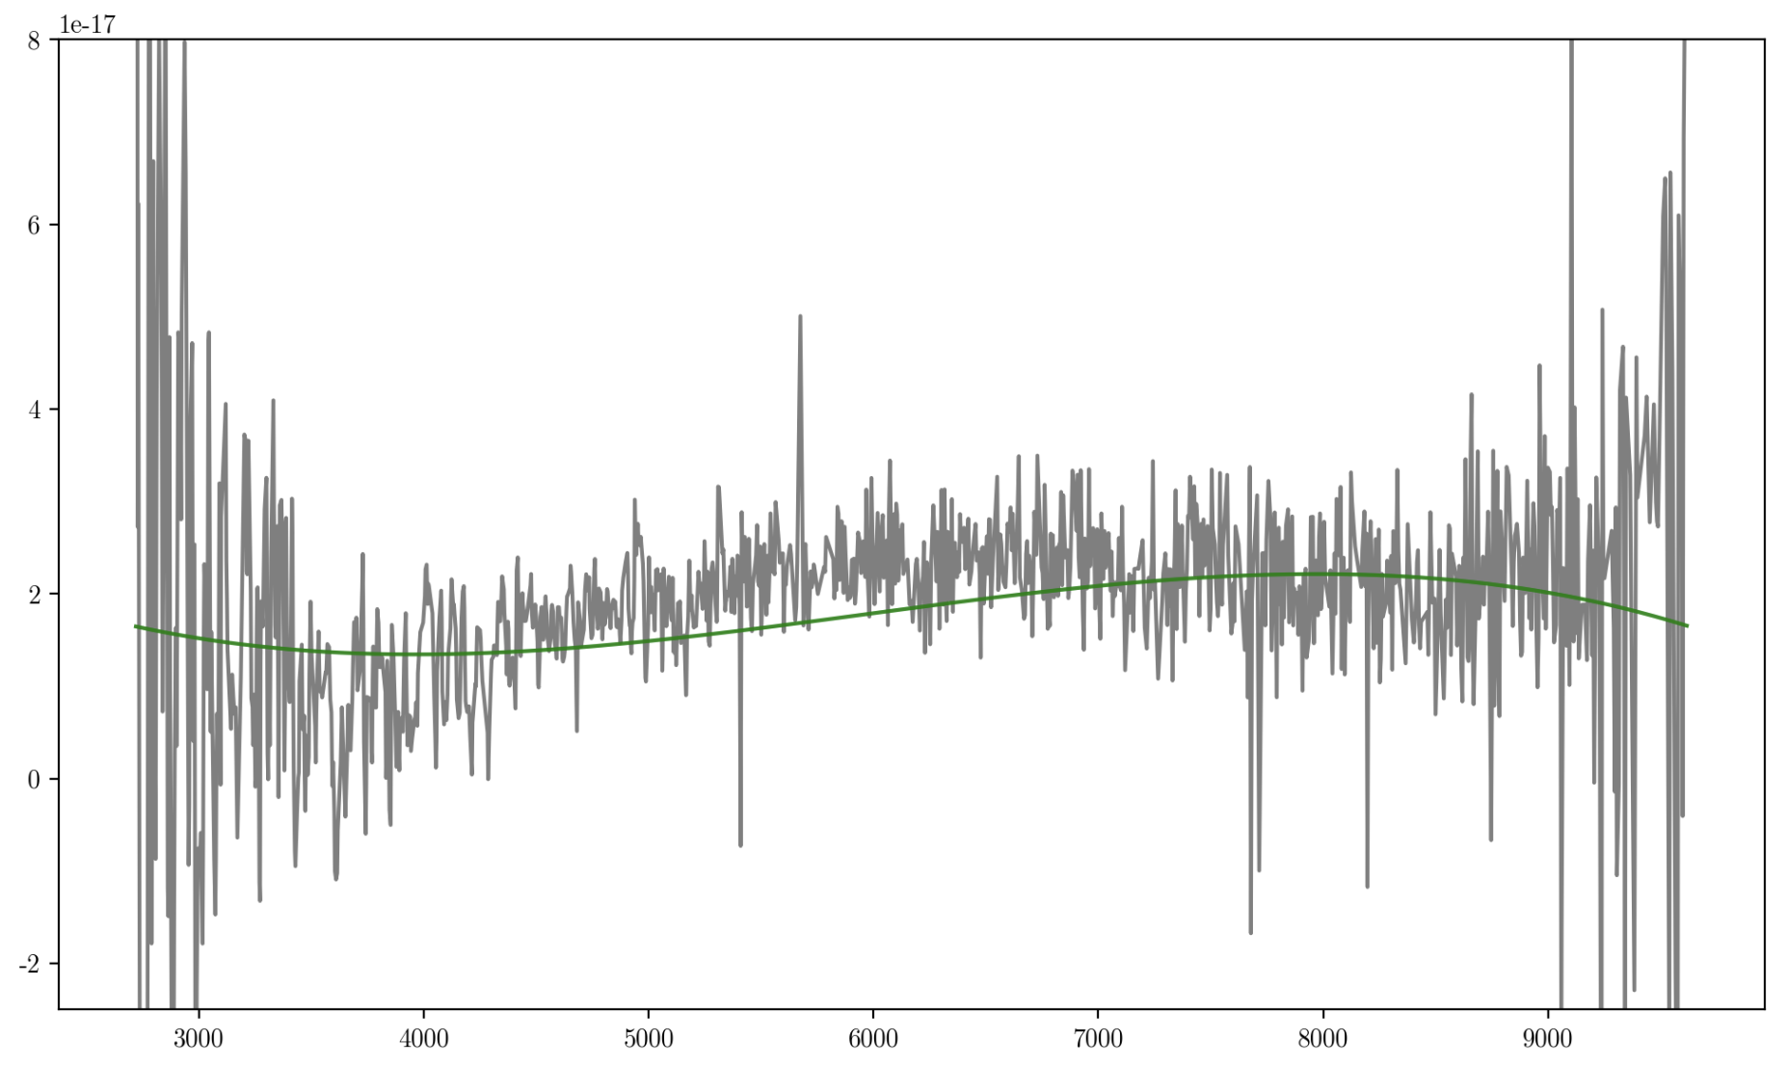
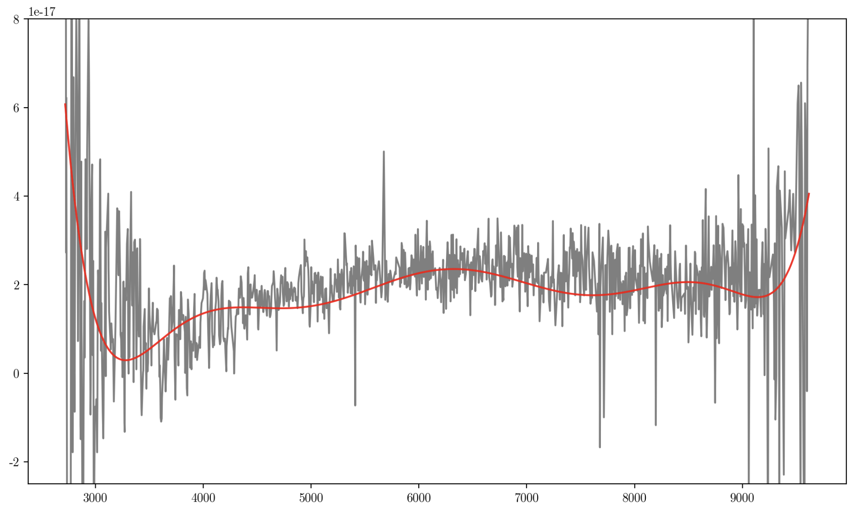
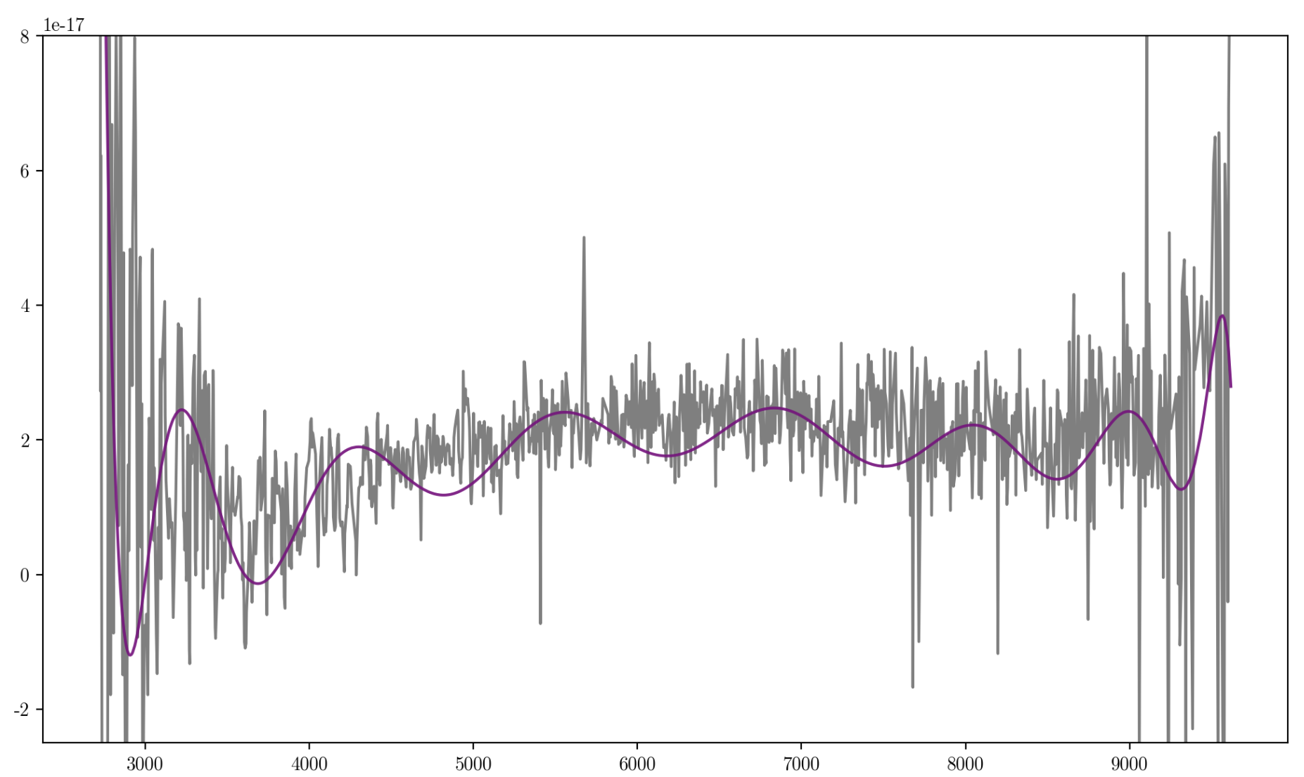

Slide 13
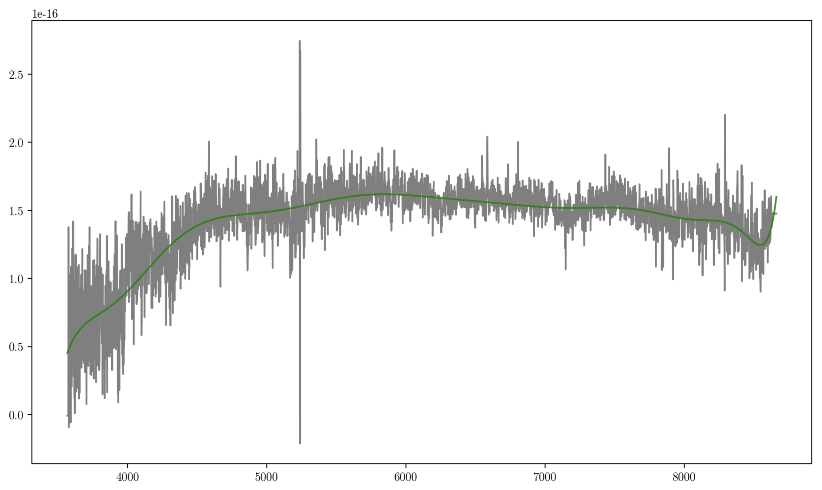
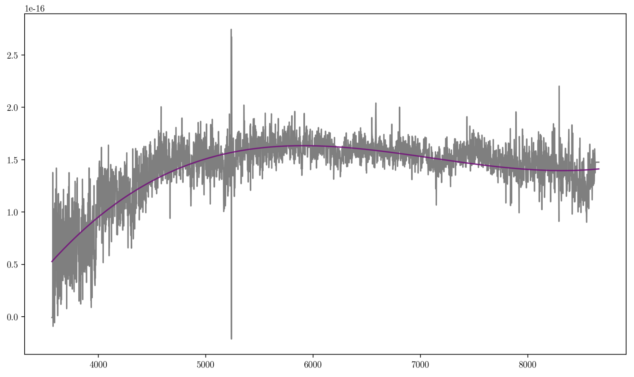
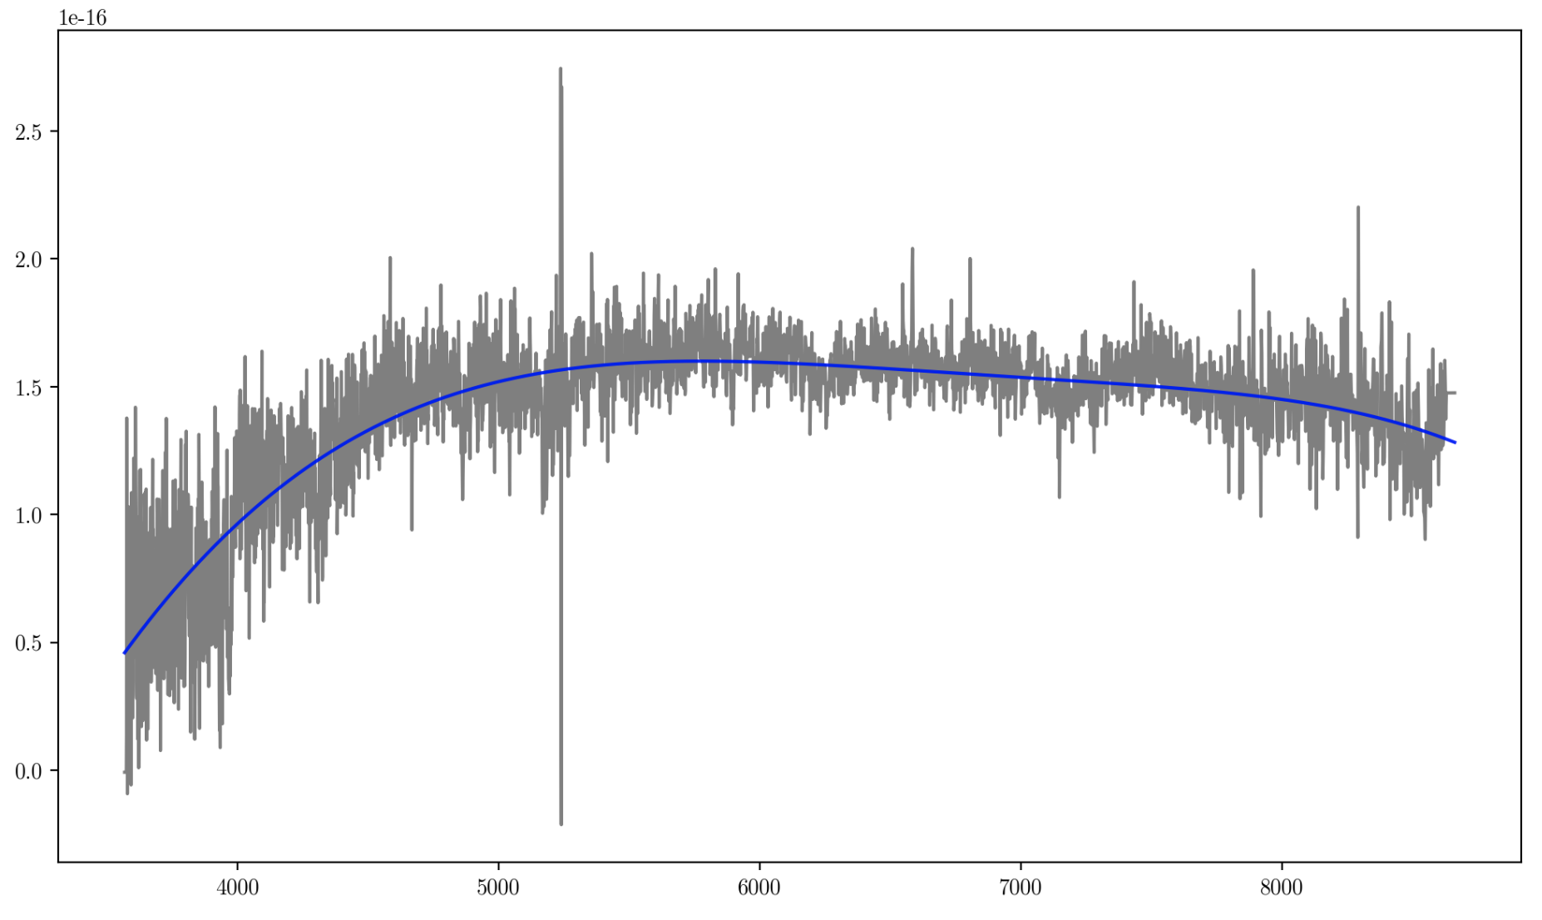
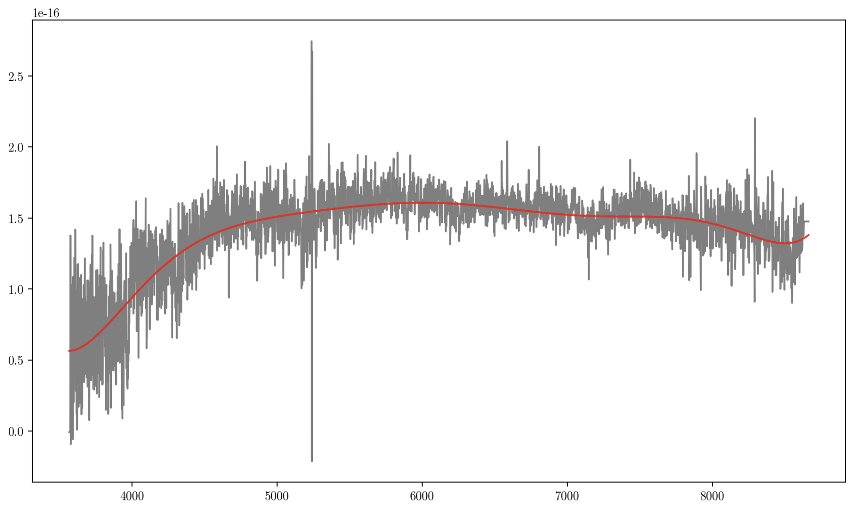

Slide 14
np.polyfit - “linear” least squares fit to data
For polynomials (including zero-order AKA lines)
You have to give the order N of the polynomial (an assumption!)
Solves the matrix equation directly to get all coefficients of N-order polynomial, guaranteeing the absolute “best fit” possible to your data
scipy.optimize.curve_fit - non-linear least squares
For all functions (e^x, log, etc)
Will not (can not!) solve an equation, will instead minimize the difference between model and data
Basically minimizing Chi-Square
It will have to test many model parameters to come up with a “minimized” solution - it is still, somewhat, a guess!
Can use np.linalg.lstsq or scipy.optimize.least_squares to fit your models directly without relying on other black-box parameters hard-coded into polyfit/curve_fit

Slide 15
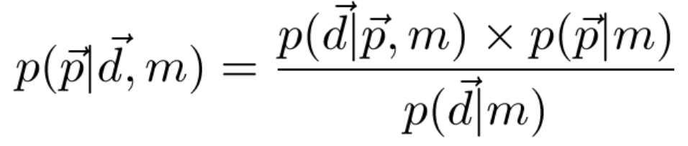

Is there a better way???
Chi-Square vs. Bayesian
Related to a probability - the “likelihood”:
Also related to a probability:
Minimizing chi-squared is equivalent to maximising likelihood, because the exponential is monotonic
One of these terms should look familiar!

